Slide 1
Reuse & Emergency Preparedness
Teresa Favuzzi, California Foundation for Independent Living Centers
Vance Taylor, Governor’s Office of Emergency Services
Dwight Bateman, Department of Rehabilitation
Sandra Graham, Disability Resource Agency for Independent Living
Ability Tools Reuse Conference
June 20, 2016, Sacramento

Slide 2
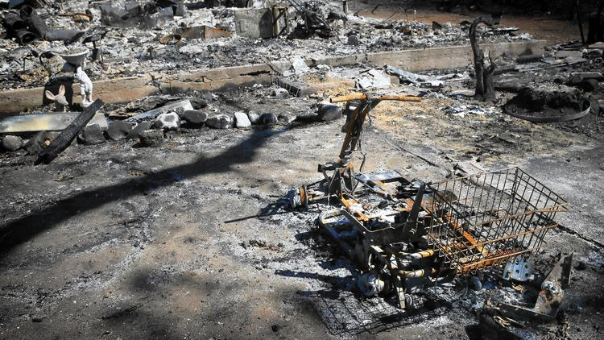
California WILDFIRES 2015
What happened?

Slide 3
PARTNERSHIPS in RESPONSE
Government Partners
Governor’s Office of Emergency Services
Department of Rehabilitation
Department of Social Services--FAST
Non-Profit Disability Community Partners
Portlight Strategies
California Foundation for Independent Living Centers
Disability Resource Agency for Independent Living
Independent Living Resources Contra Costa, Solano
Disability Services & Legal Center
American Red Cross

Slide 4
Governor’s Office of Emergency Services
Office of Access & Functional Needs
Response
Deployment
Daily Partner Calls
Central Communications

Slide 5
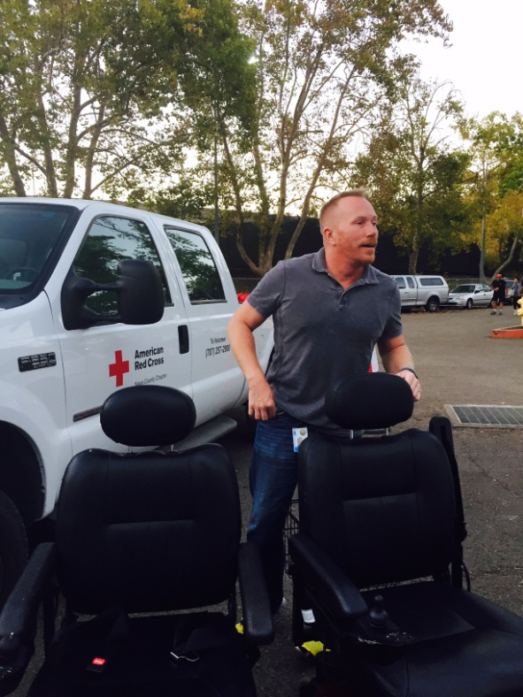
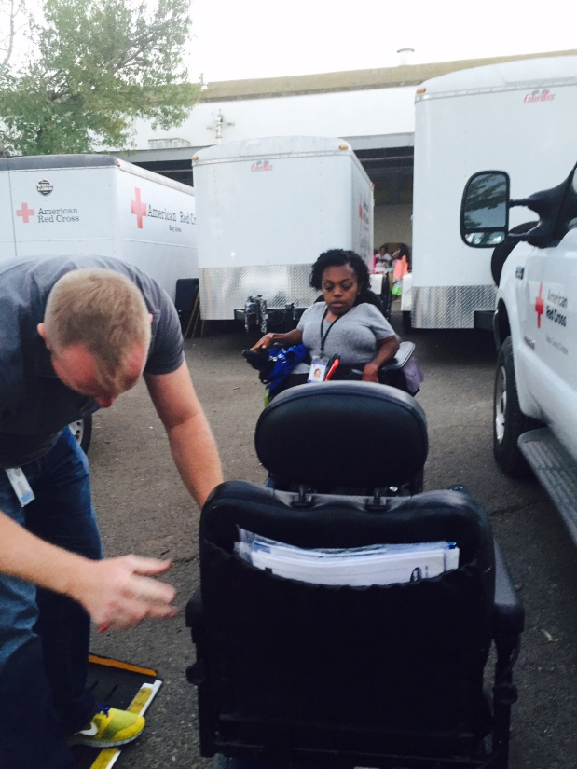
Department of Rehabilitation
Independent Living Section
Response
Deployment
Transportation

Slide 6
National Non-Profit
Portlight Strategies
Collaboration
National Reuse
Deployment

Slide 7
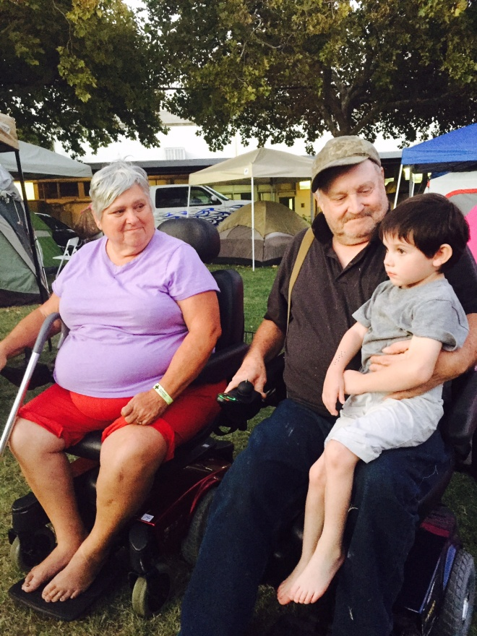
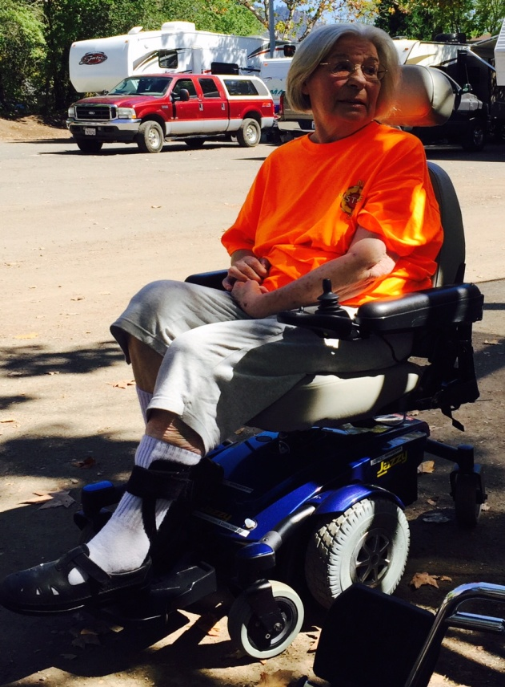
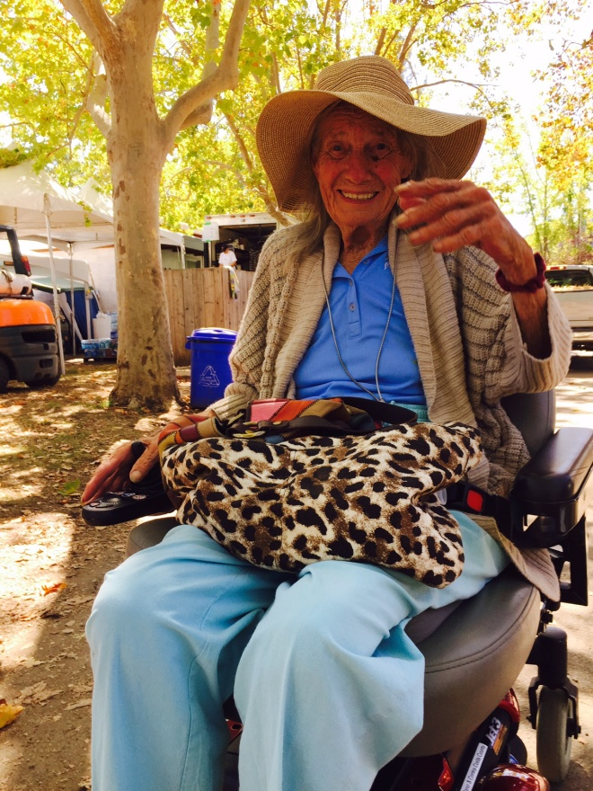
State Non-Profit
Ability Tools
Deployment – Reuse – Post Wildfire

Slide 8
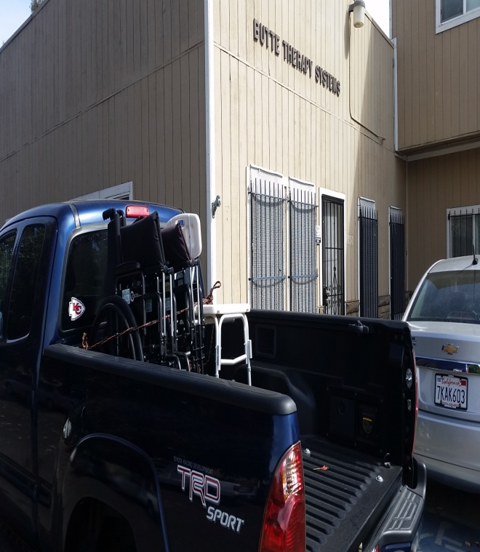
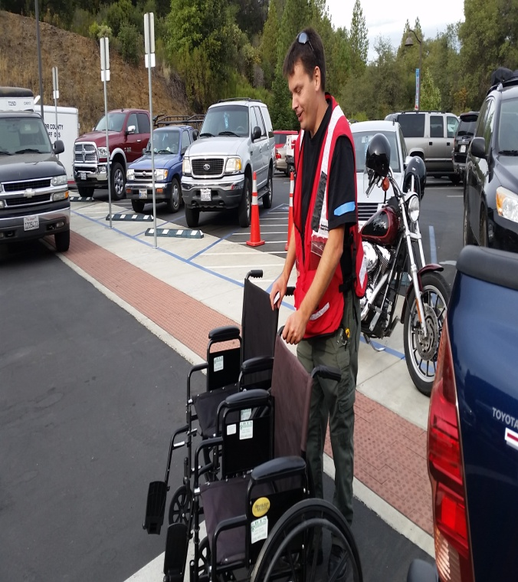
Local Non-Profit
Disability Resource Agency for
Independent Living
Response
Deployment
Access
Delivery

Slide 9
LESSONS LEARNED
Reuse Plays Initial Critical Role
Barriers
Access to Nearby Equipment
Individual Needs
Transportation & Shipping
COORDINATION

