Slide 1

The
of running
a reuse program
Presented by:
Eddie Lopez - Assistive Technology Specialist
Deborah Uhl – Assistive Technology Coordinator

Slide 2

Independent Living Resources (ILR)
Offices in Concord, Antioch, and Fairfield
Serving Solano and Contra Costa Counties

Slide 3

Disability Action Center (DAC)
Offices in Redding and Chico
Serving Shasta, Modoc, Siskiyou, Lassen, Butte, Tehama, Glenn, and Plumas counties

Slide 4
History of
Ilr’s and DAC’s
Reuse Program

Slide 5
There is more to DME Reuse than one can imagine.
You have to be able to wear many hats.
Pick-up and delivery of DME
Mechanic and repair person
Problem solver/troubleshooter of DME
Cleaner and sanitizer
Preservation and Maintenance
Logistics organizer
Service provider and net worker
Mobility and Training
Fundraiser and grant writer
Data entry and inventory
Information and Referral
Product and Equipment Research

Slide 6

• Helping the environment
• Saving resources of government agencies
• Impacting landfills reusing DME
• Helping the local community
• Positive impact on health care costs

Slide 7
How our reuse programs have evolved

Slide 8
Independent Living Resources
Estimated current value (MSRP)of DME distributed from 2011 to 2016
$230,000.00

Slide 9
Disability Action Center
DME Reuse Services Provided
Estimated current value (MSRP)of DME distributed from 2011 to 2016
$459,201.00

Slide 10
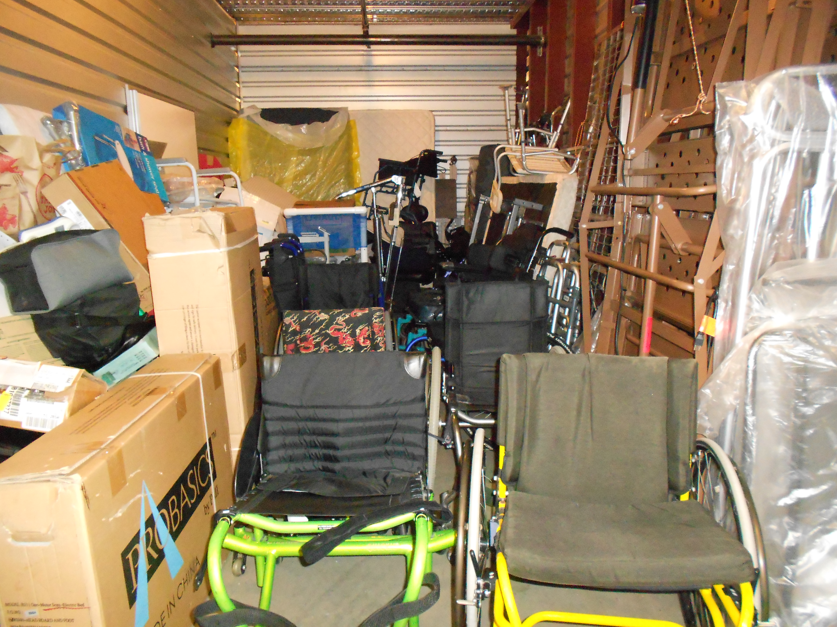
Ilr’s main storage unit
Main Storage Unit is located in Concord, CA

Slide 11
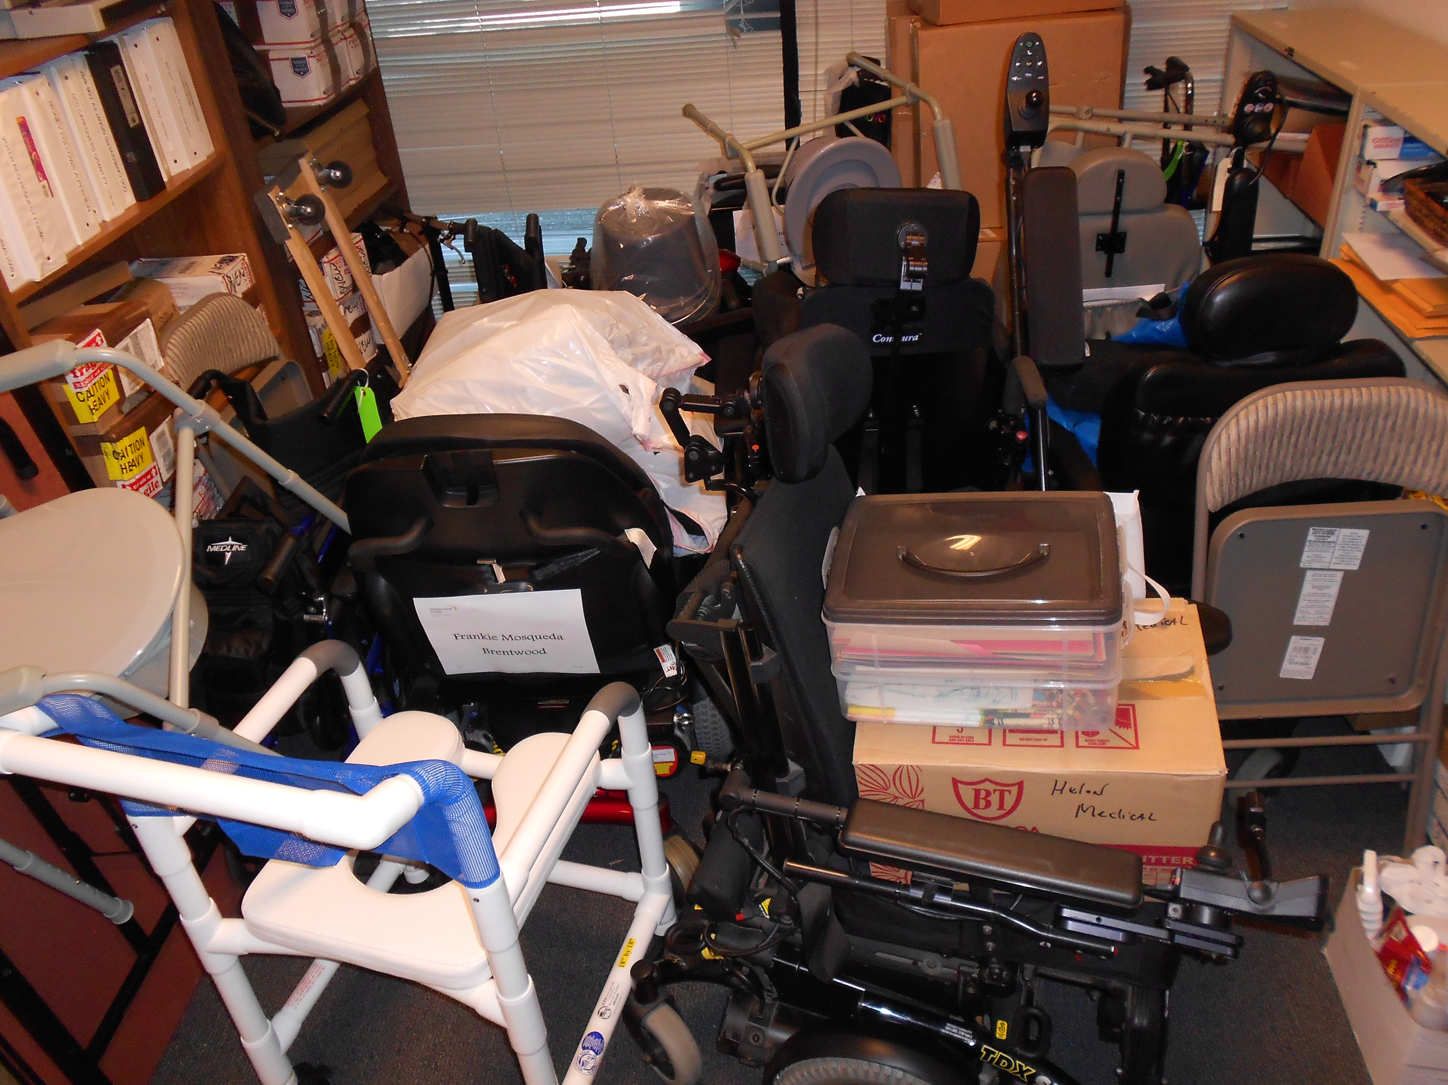
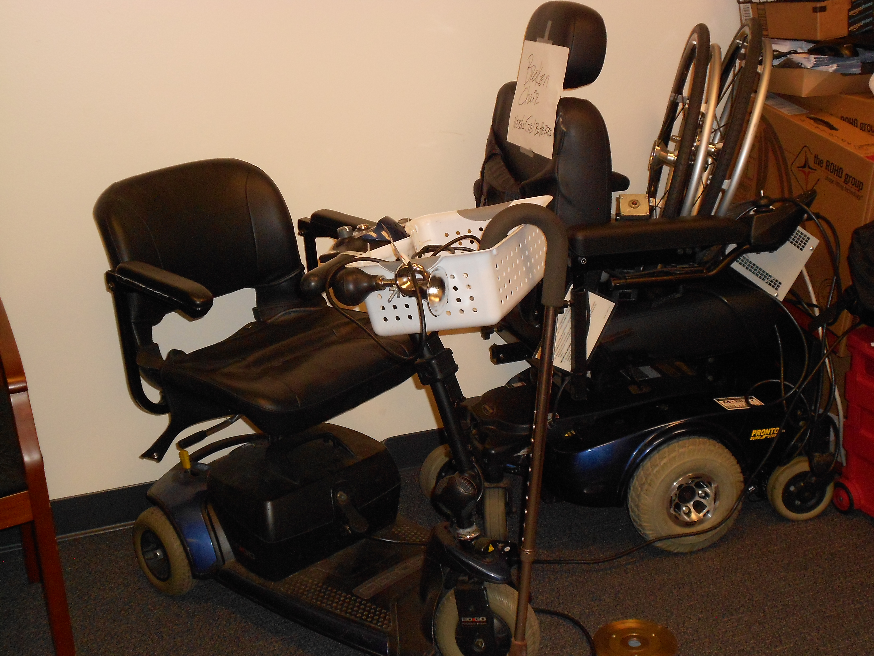
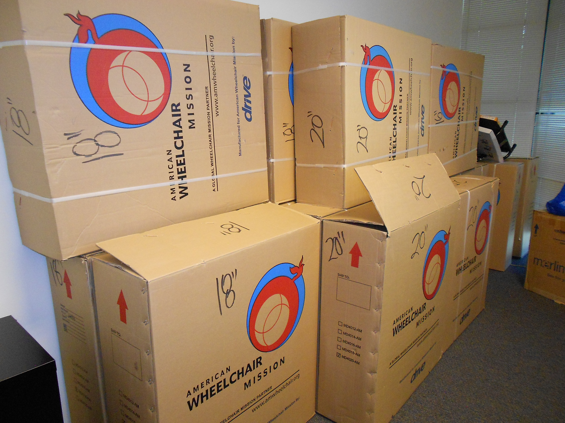
Additional Storage
Temporary Storage1
Office Storage Room
Temporary Storage 2
My Office
Temporary Storage 3
My Other Office

Slide 12
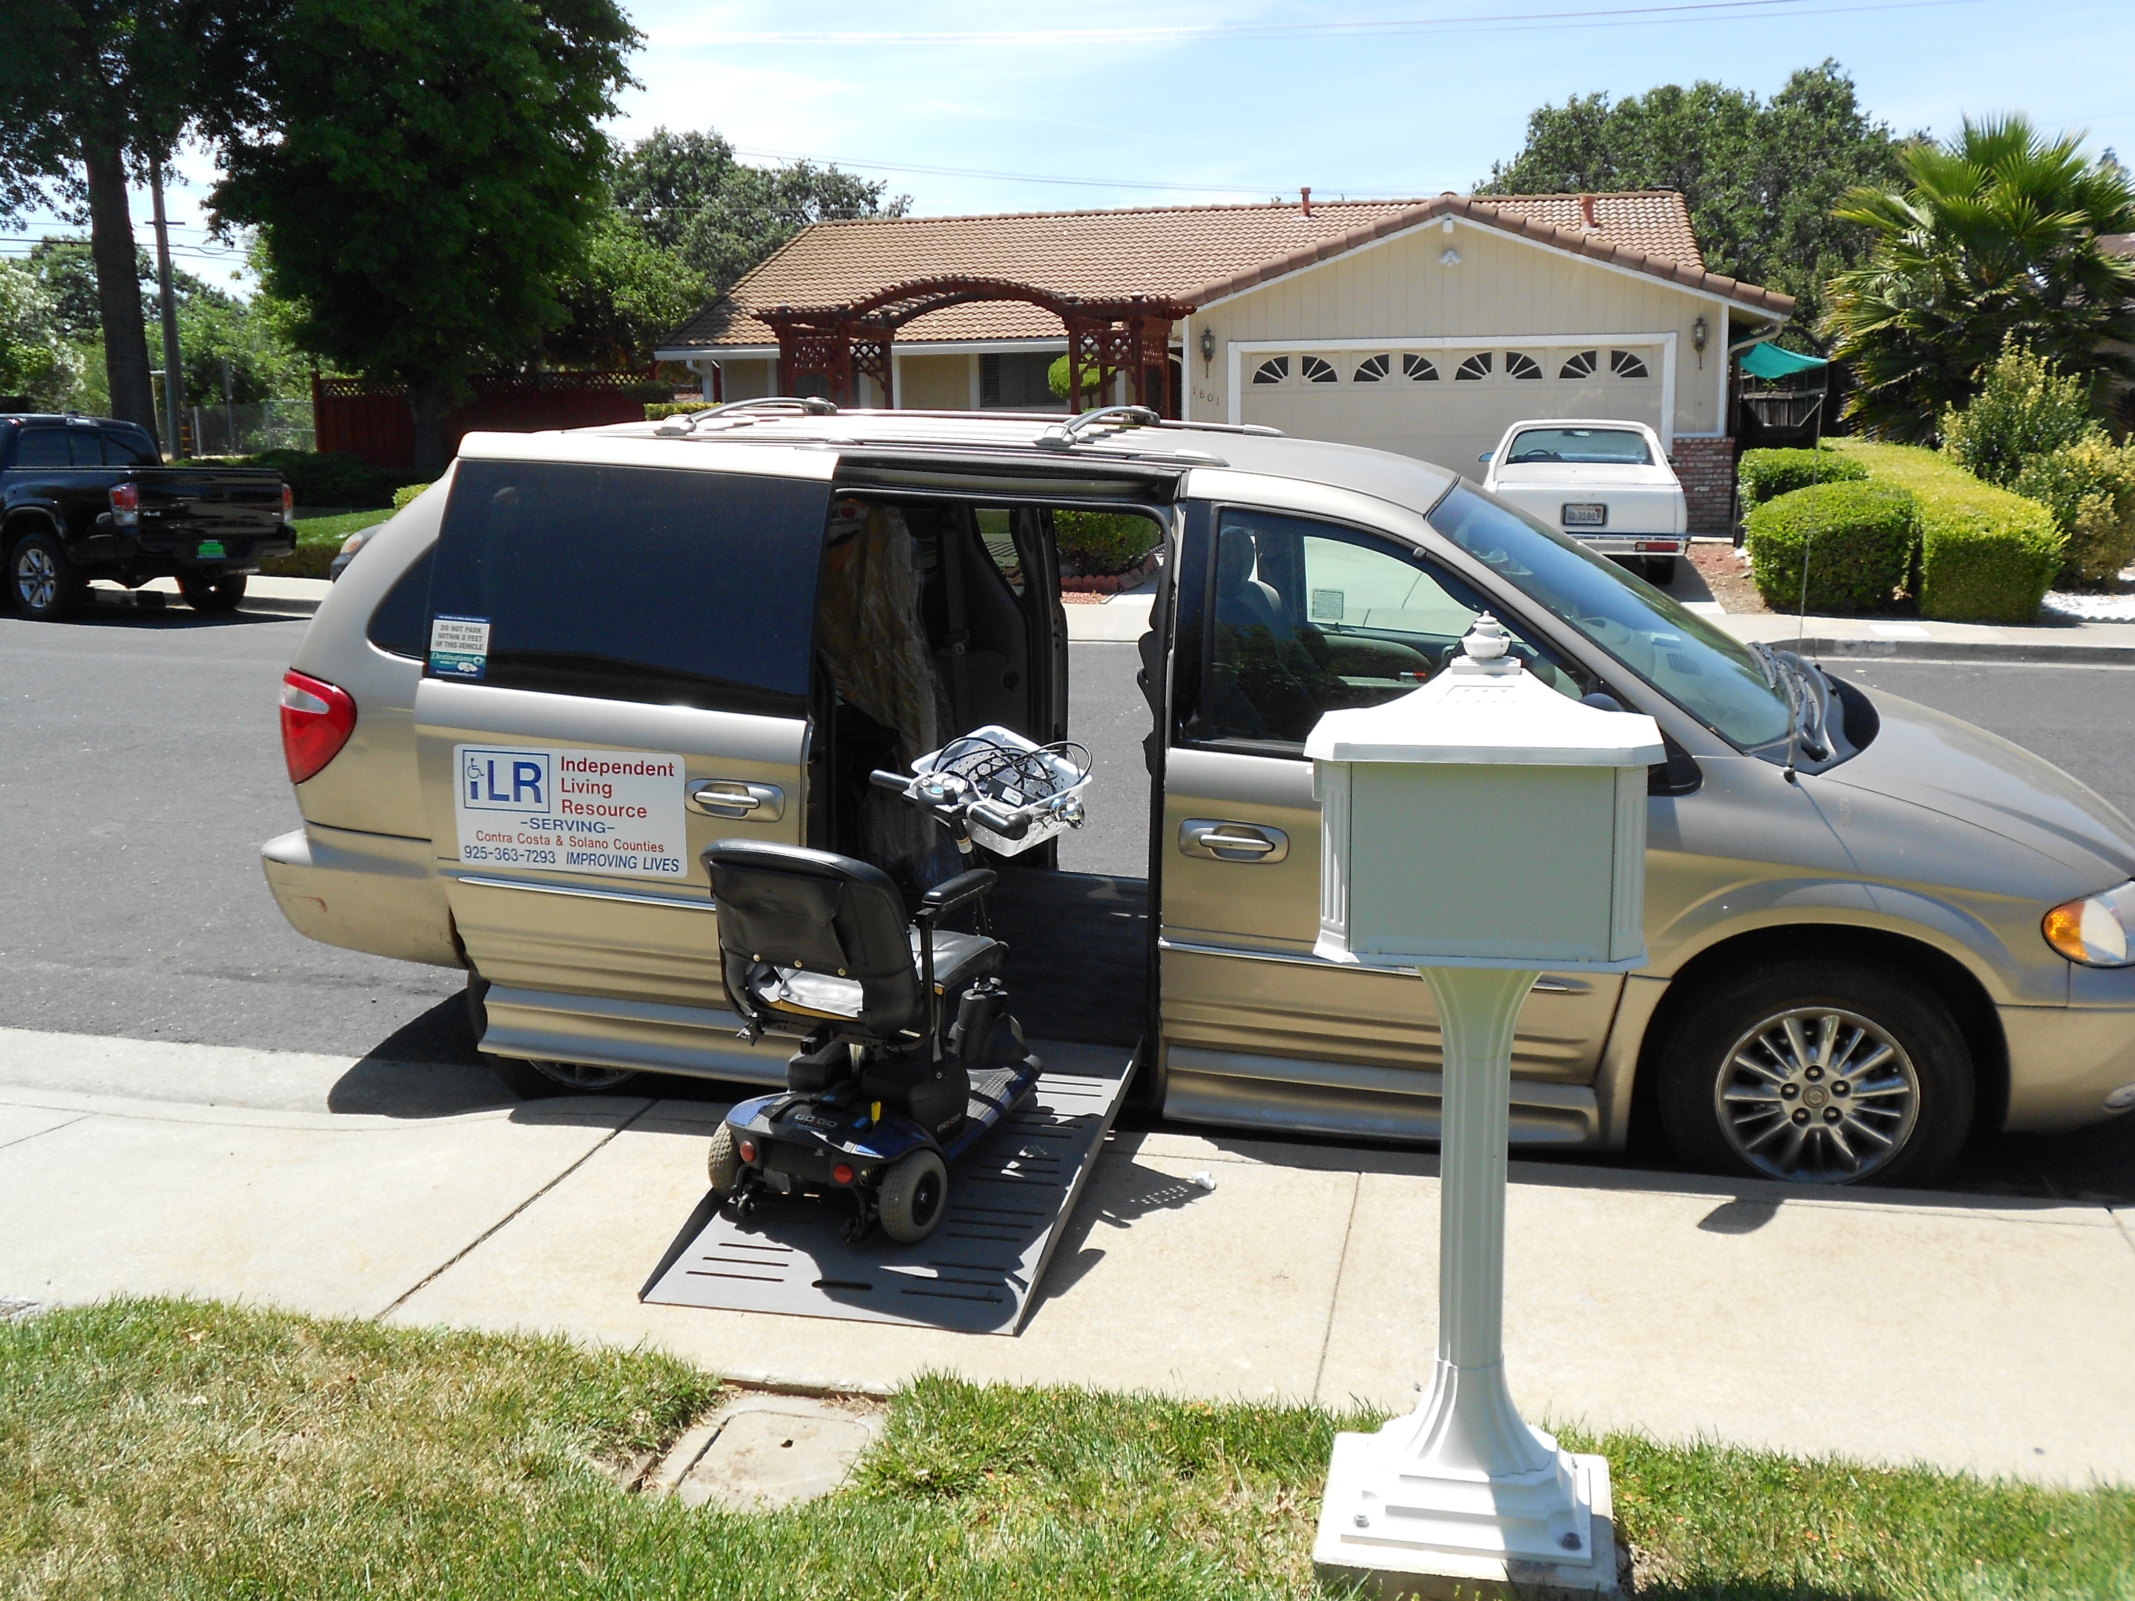
Picking up donations
Members of the community call ILRSCC to donate DME’s

Slide 13
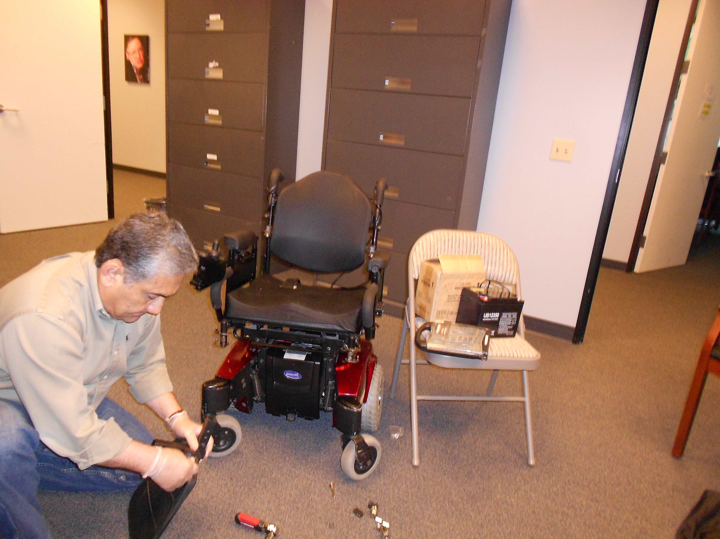
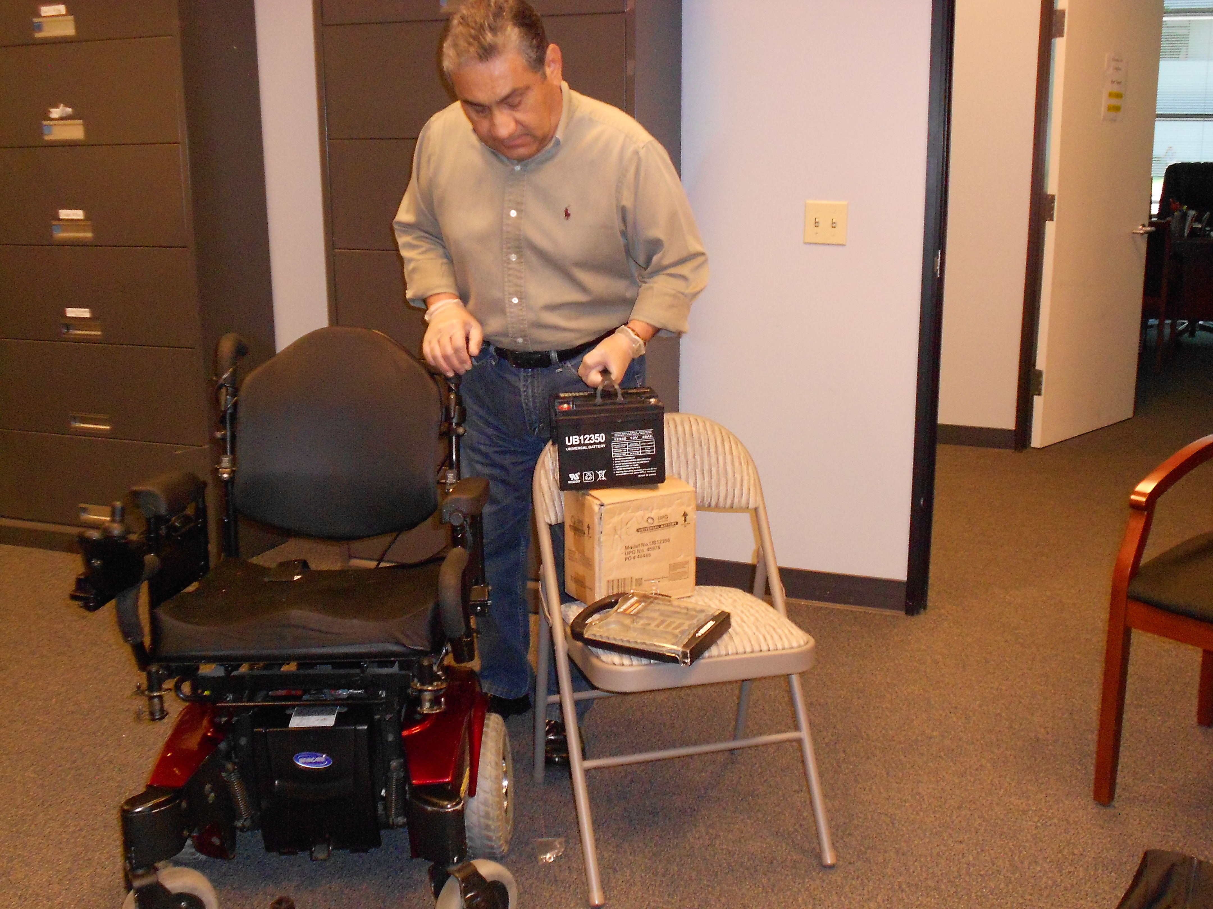
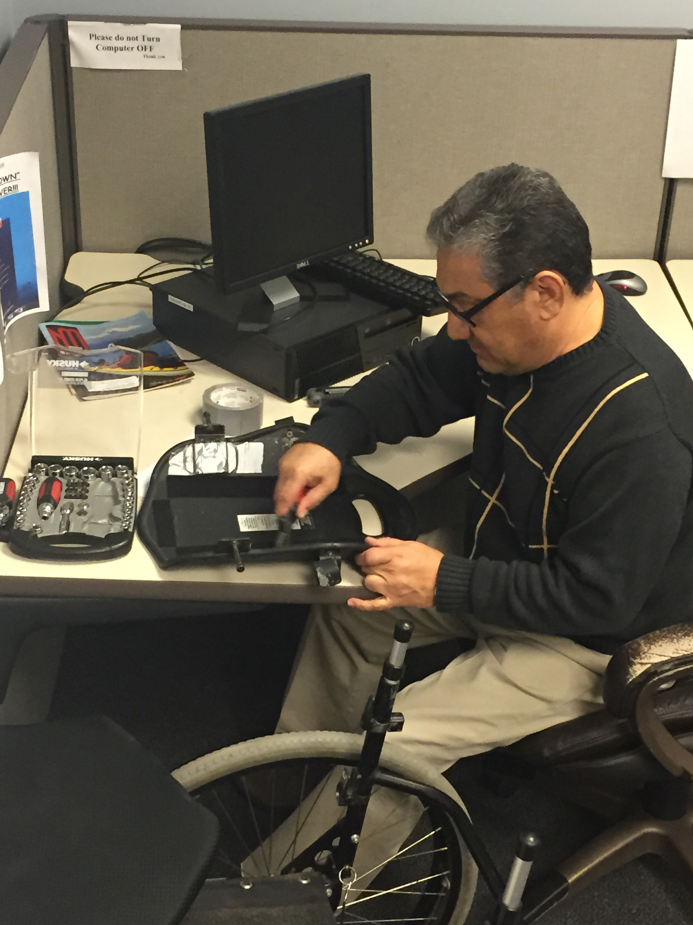
Mechanic on duty
Mechanic Repairing foot rest
Installing New Batteries for a PWC
Fixing Back Support for a Manual Chair

Slide 14
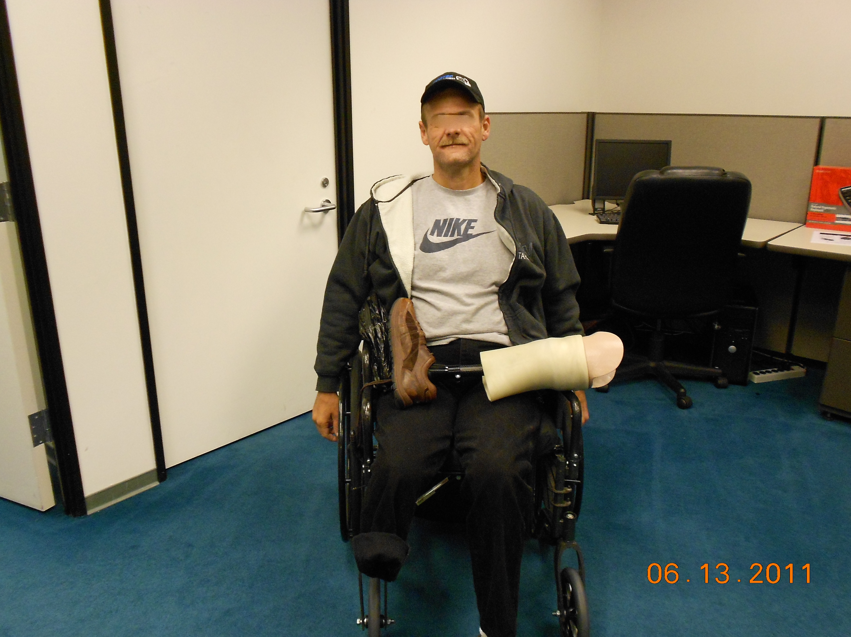
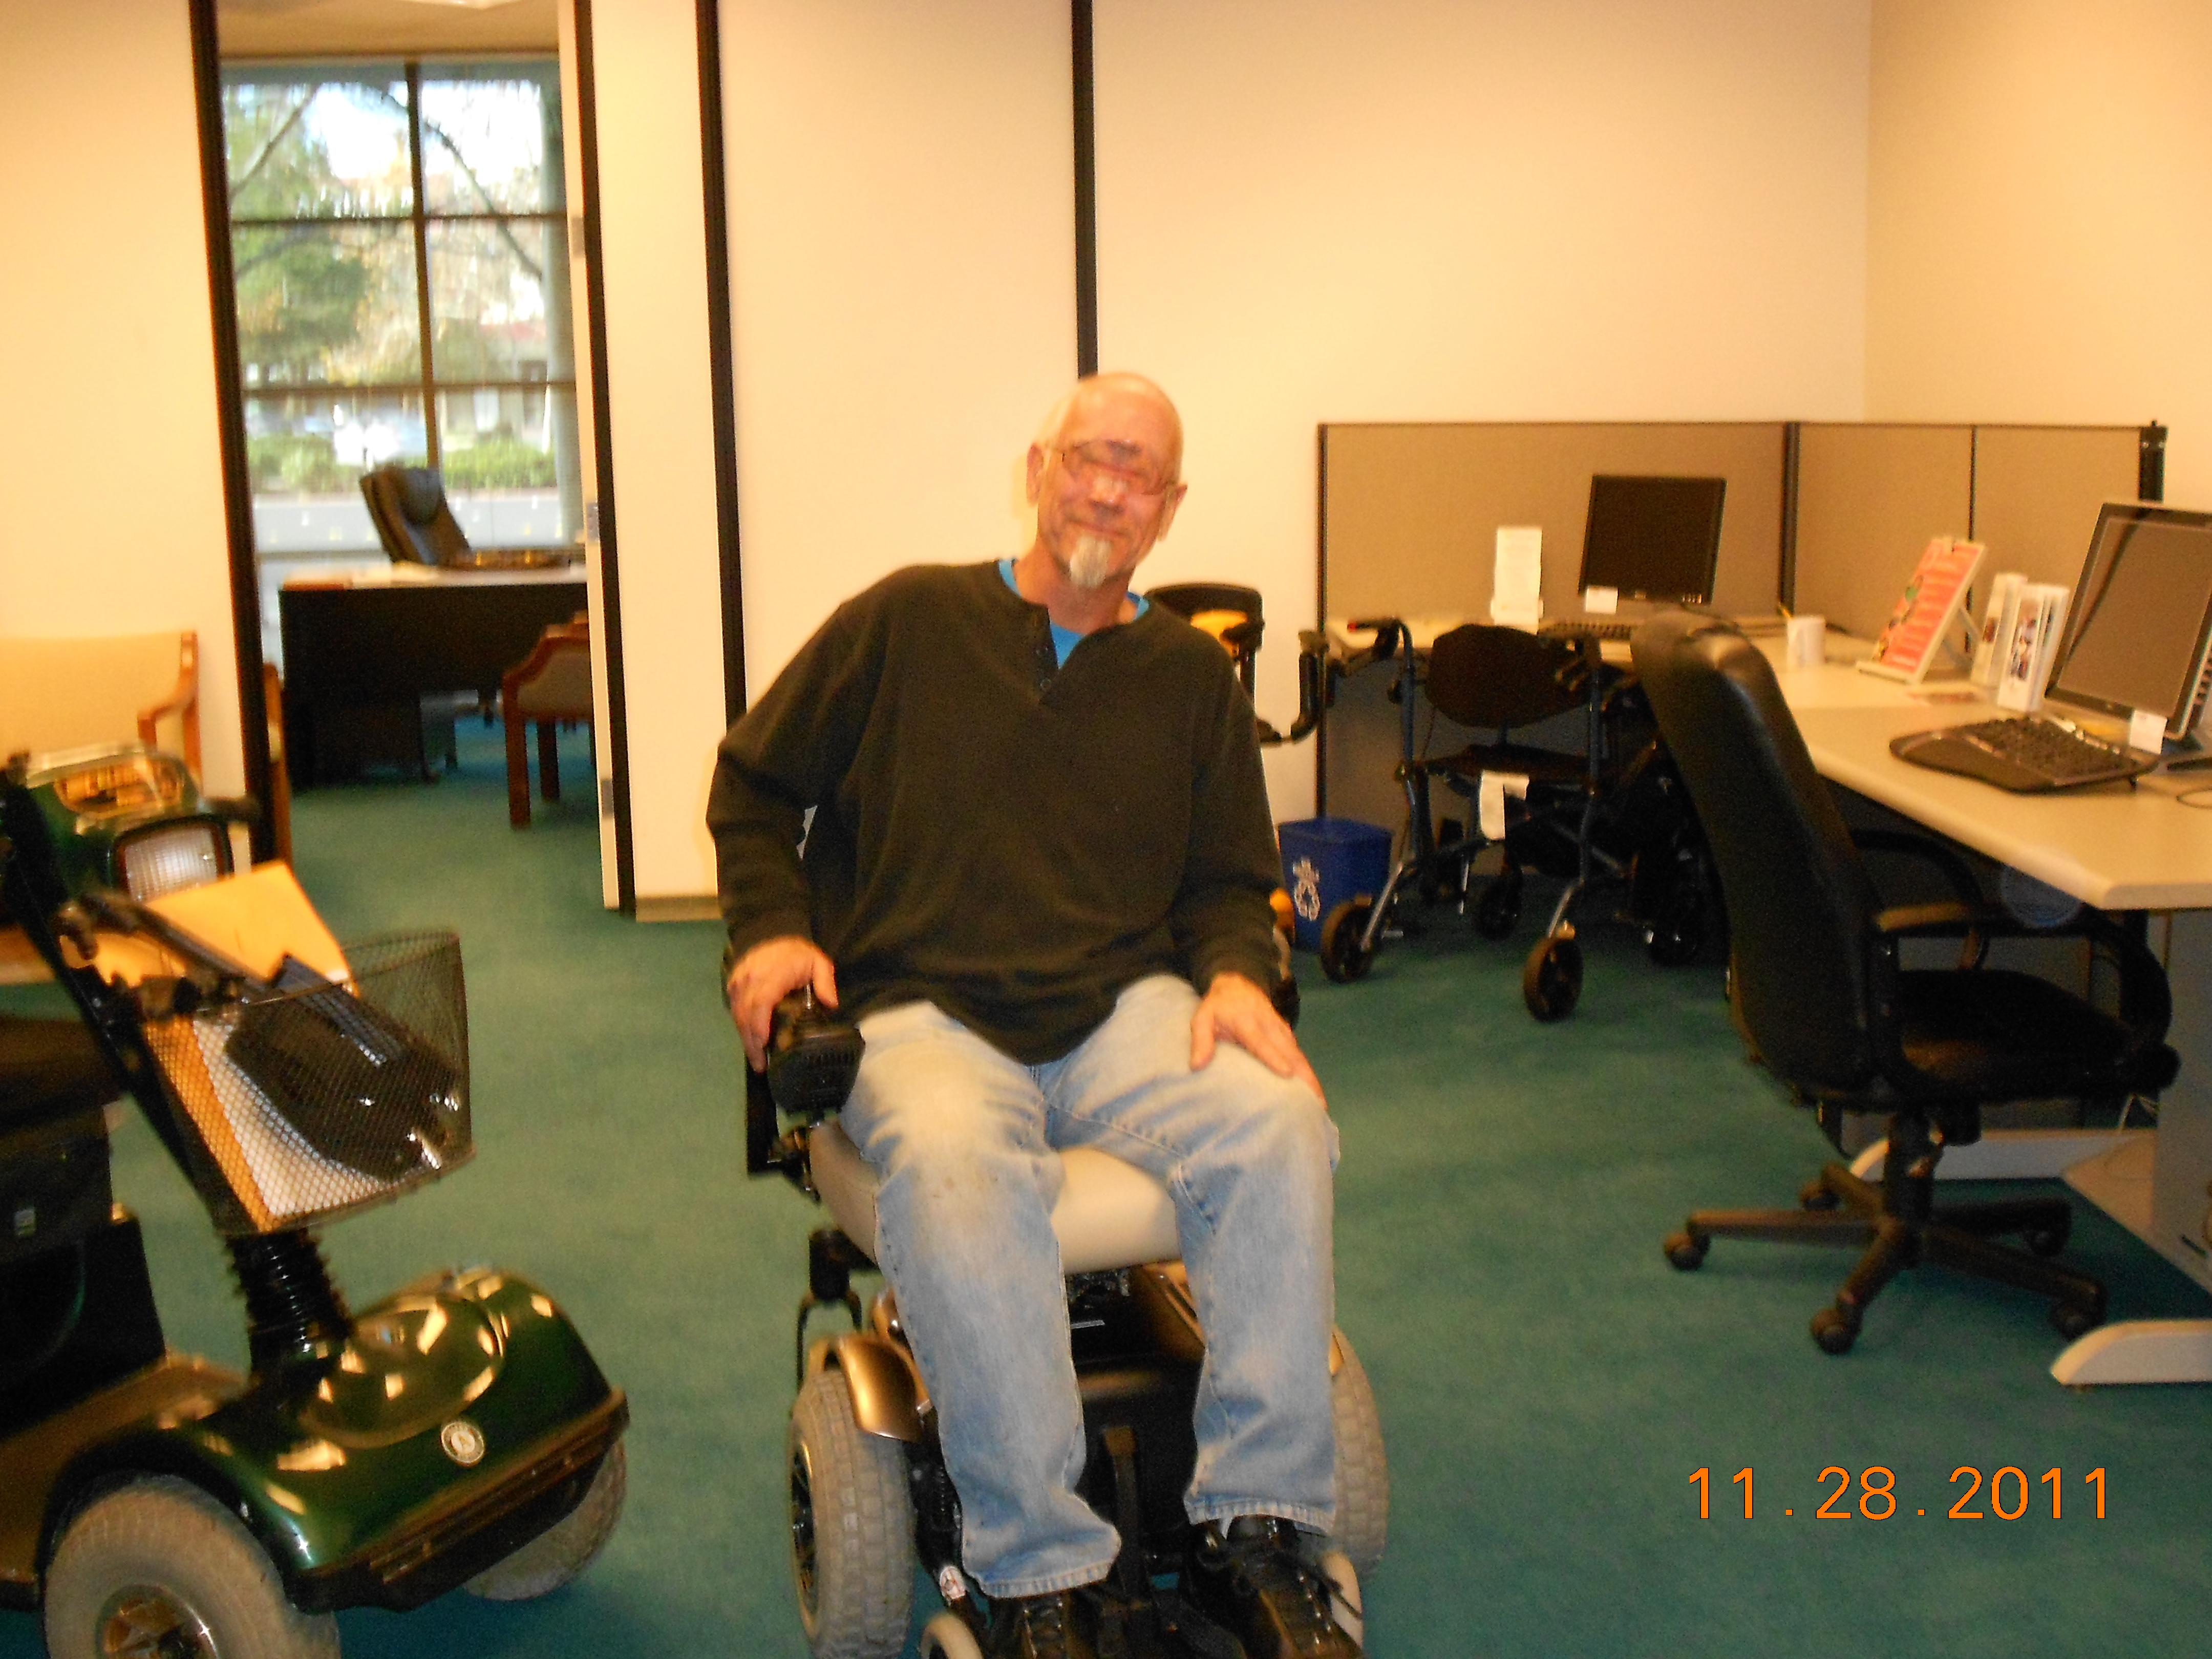
Some Ilr’s Happy consumers

Slide 15
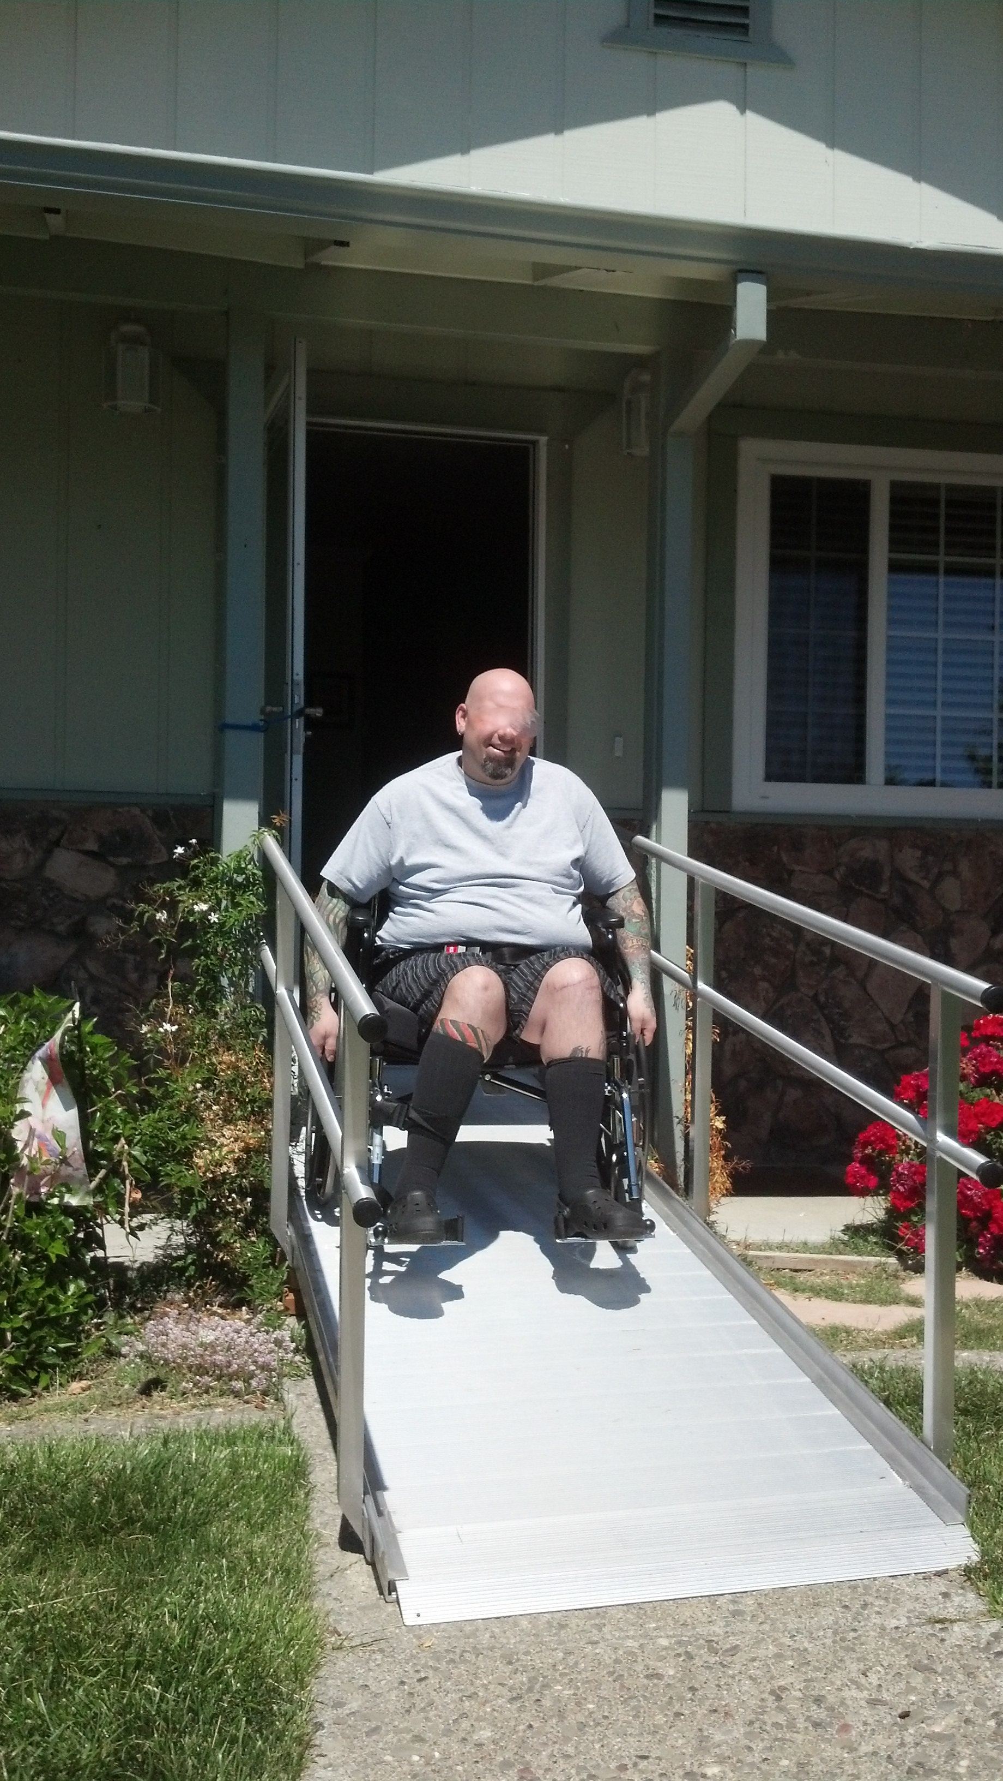
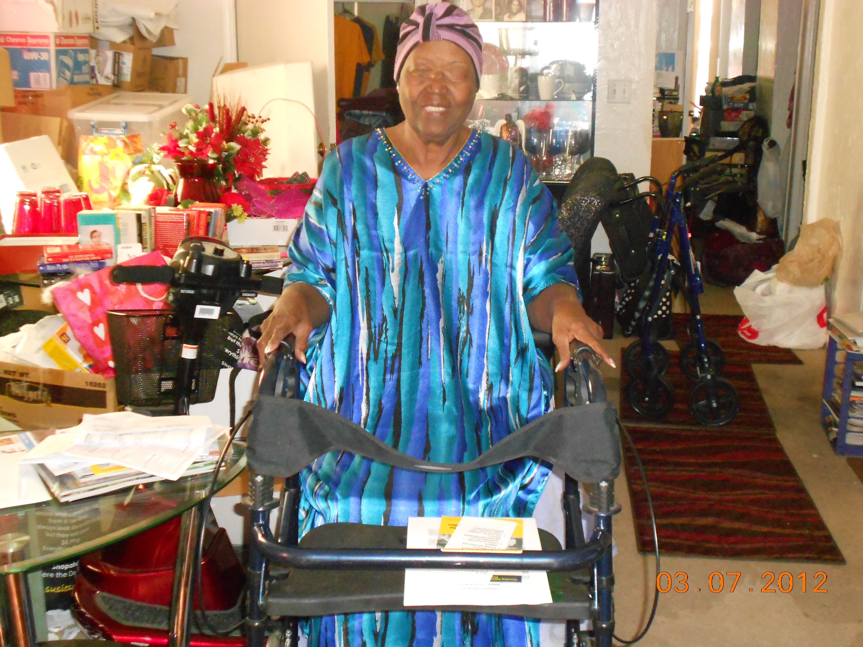
More ilr’s happy consumers

Slide 16
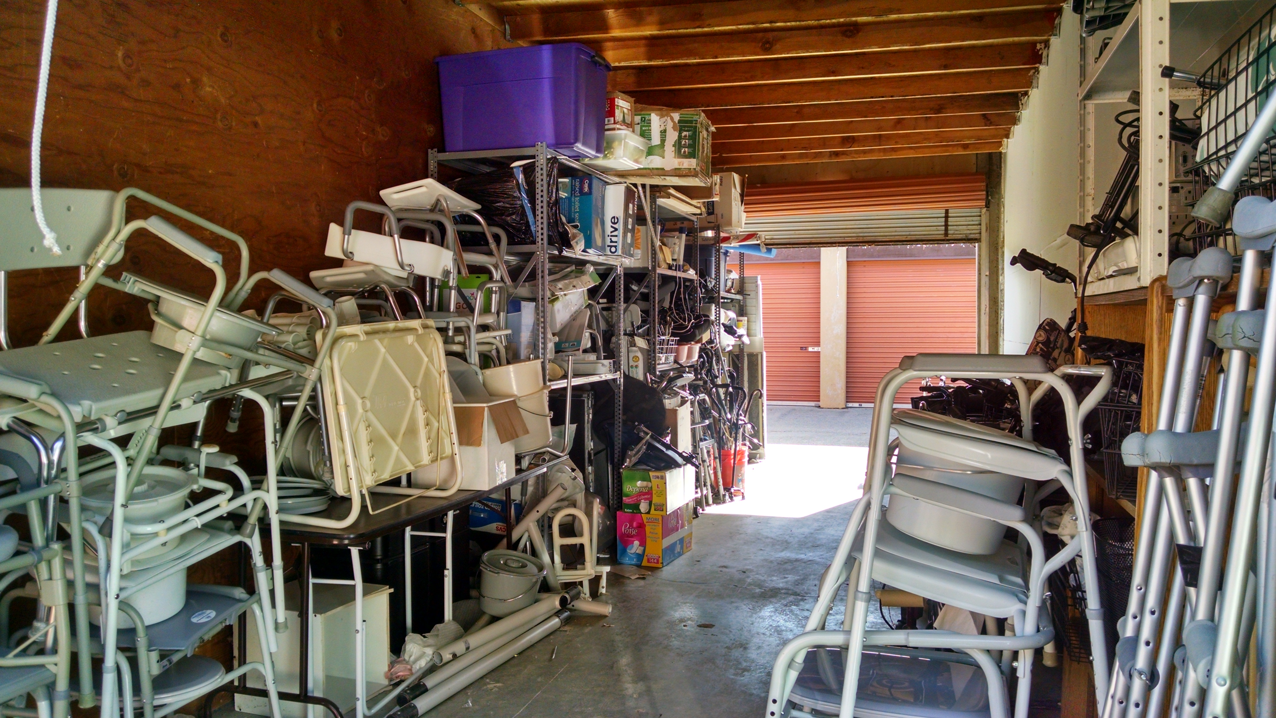
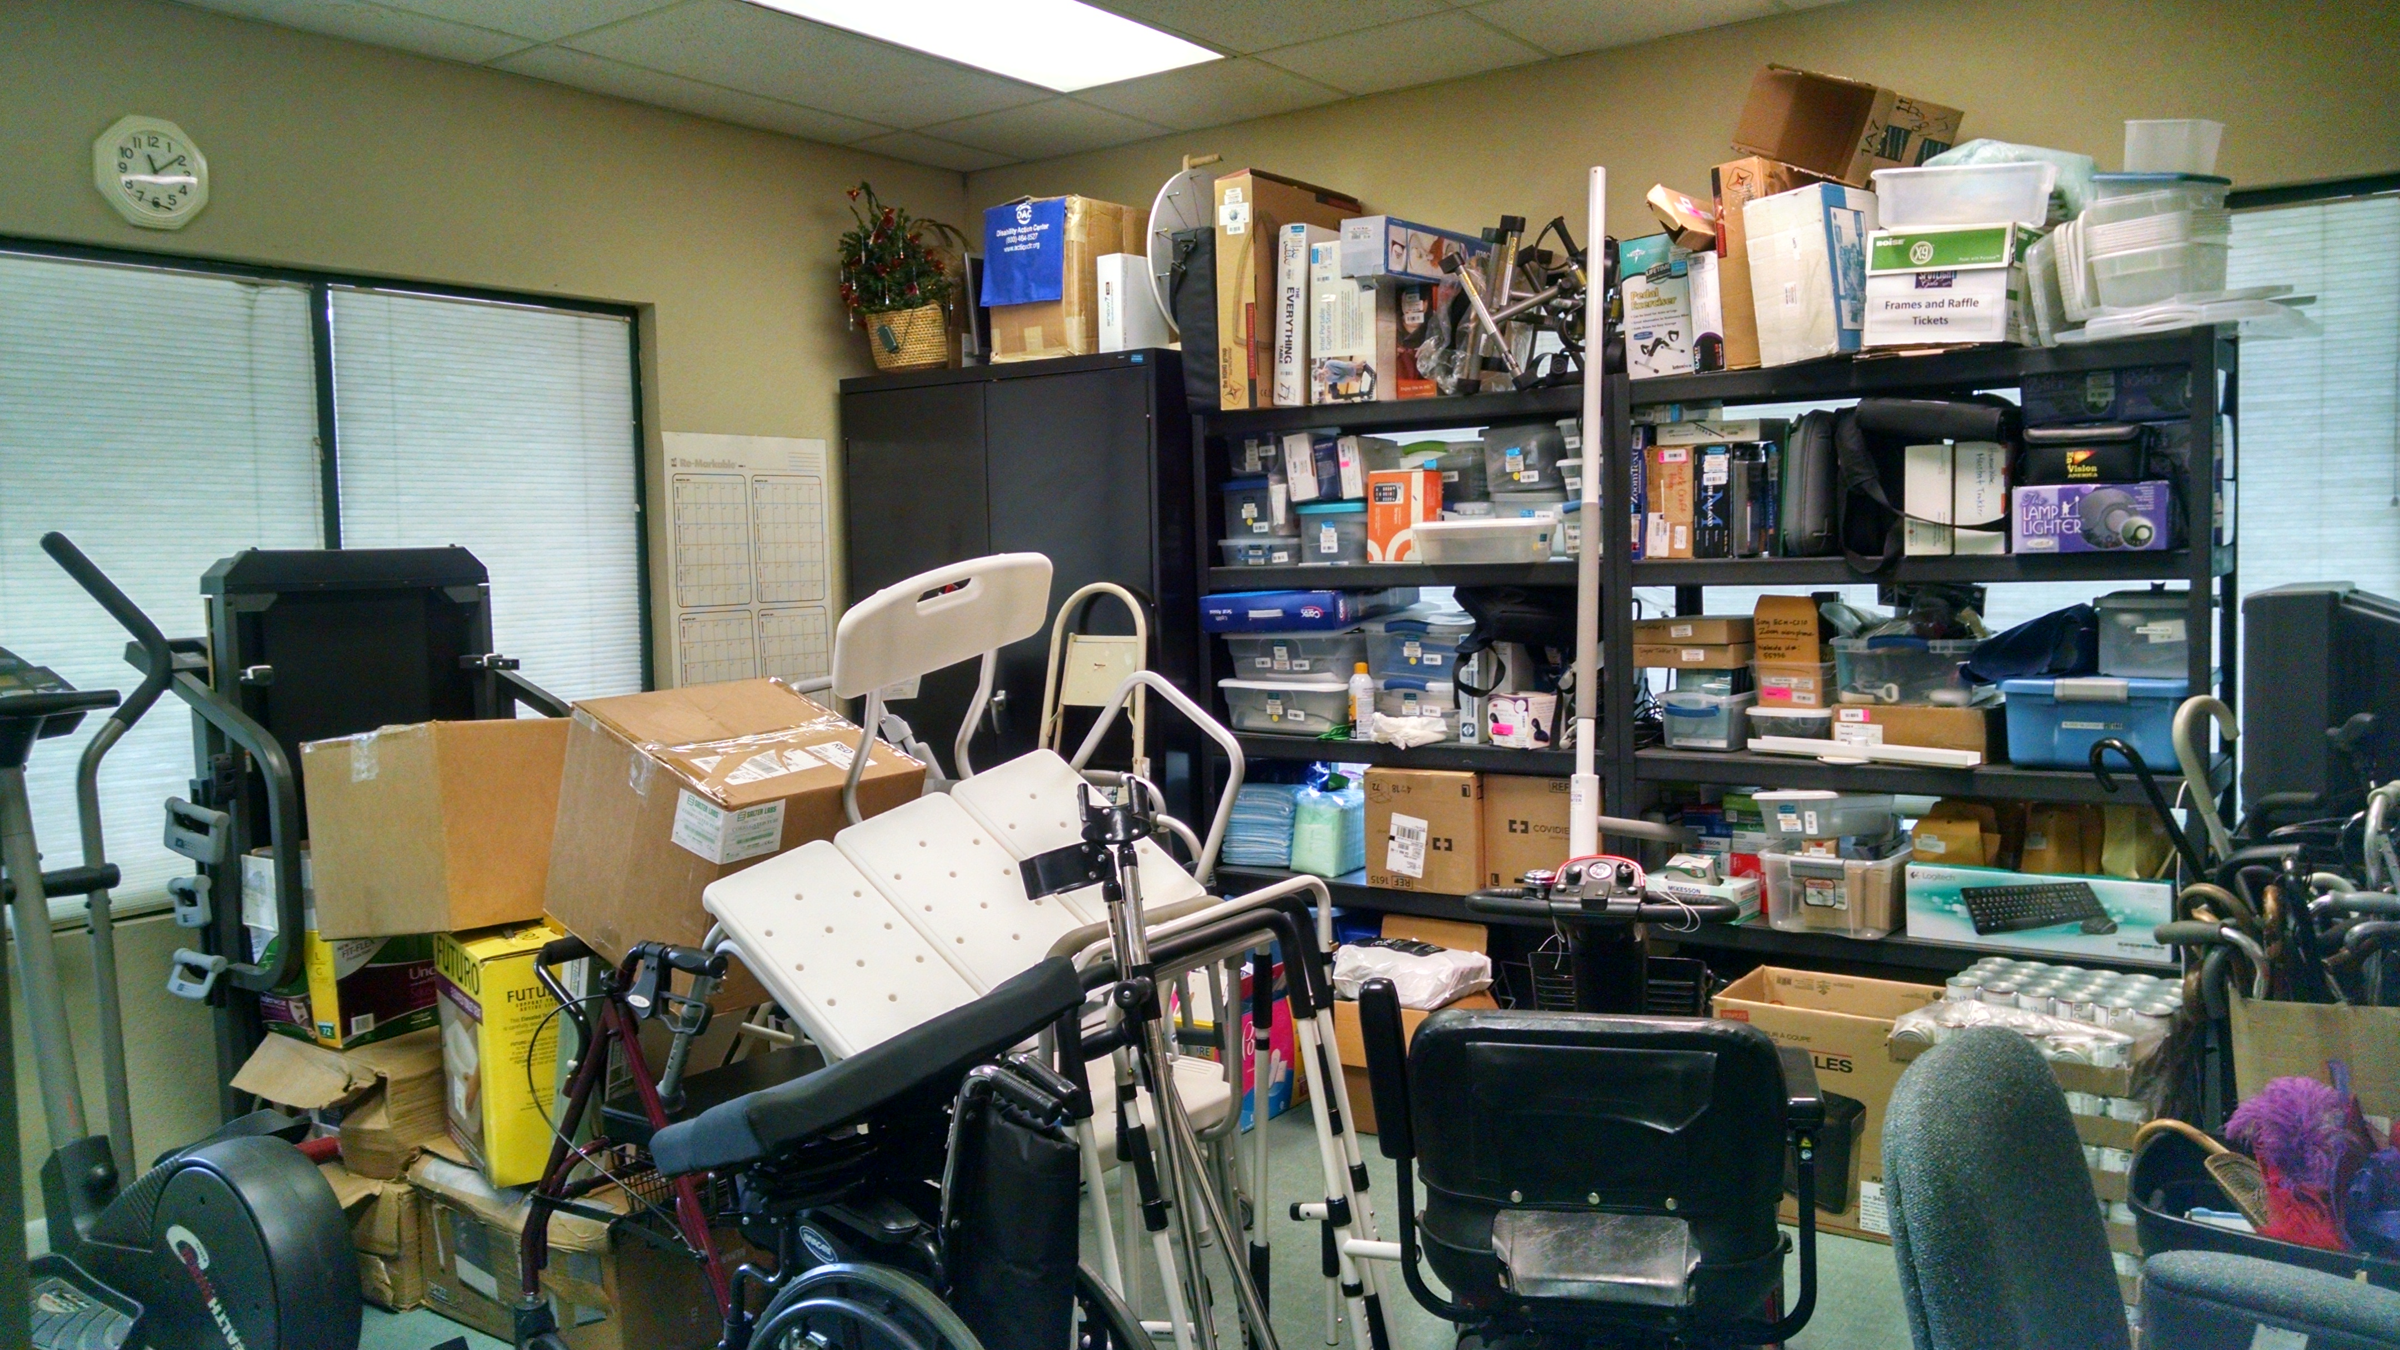
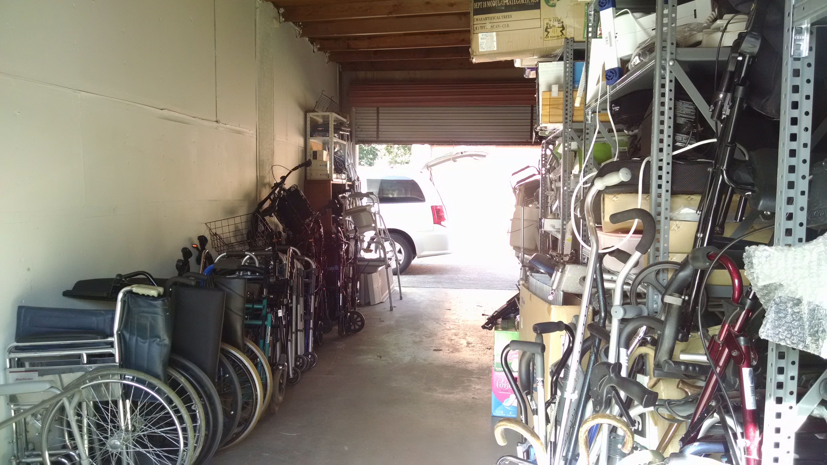
DAC’s dme storage
10x30 Storage Unit Front
Weekly Drop Off
aka Conference Room
10x30 Storage Unit Back

Slide 17
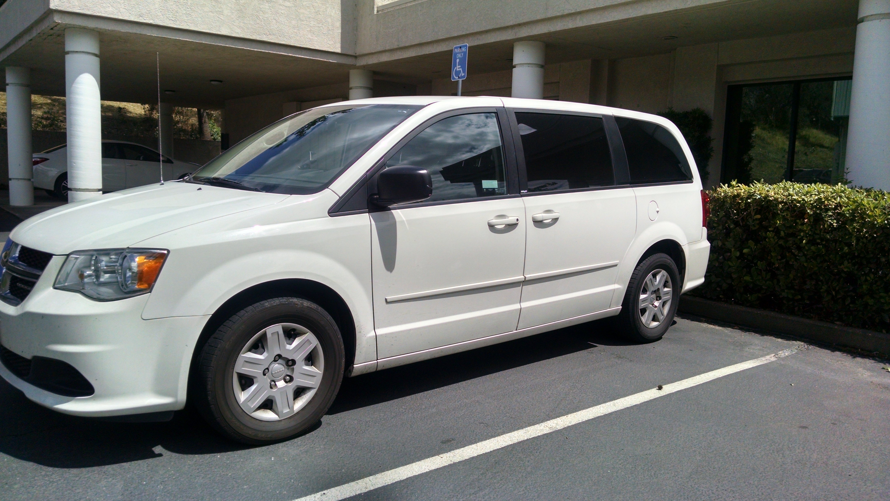
DAC’s dme reuse vehicles
2004 GMC Savanah
2011 Dodge Caravan

Slide 18
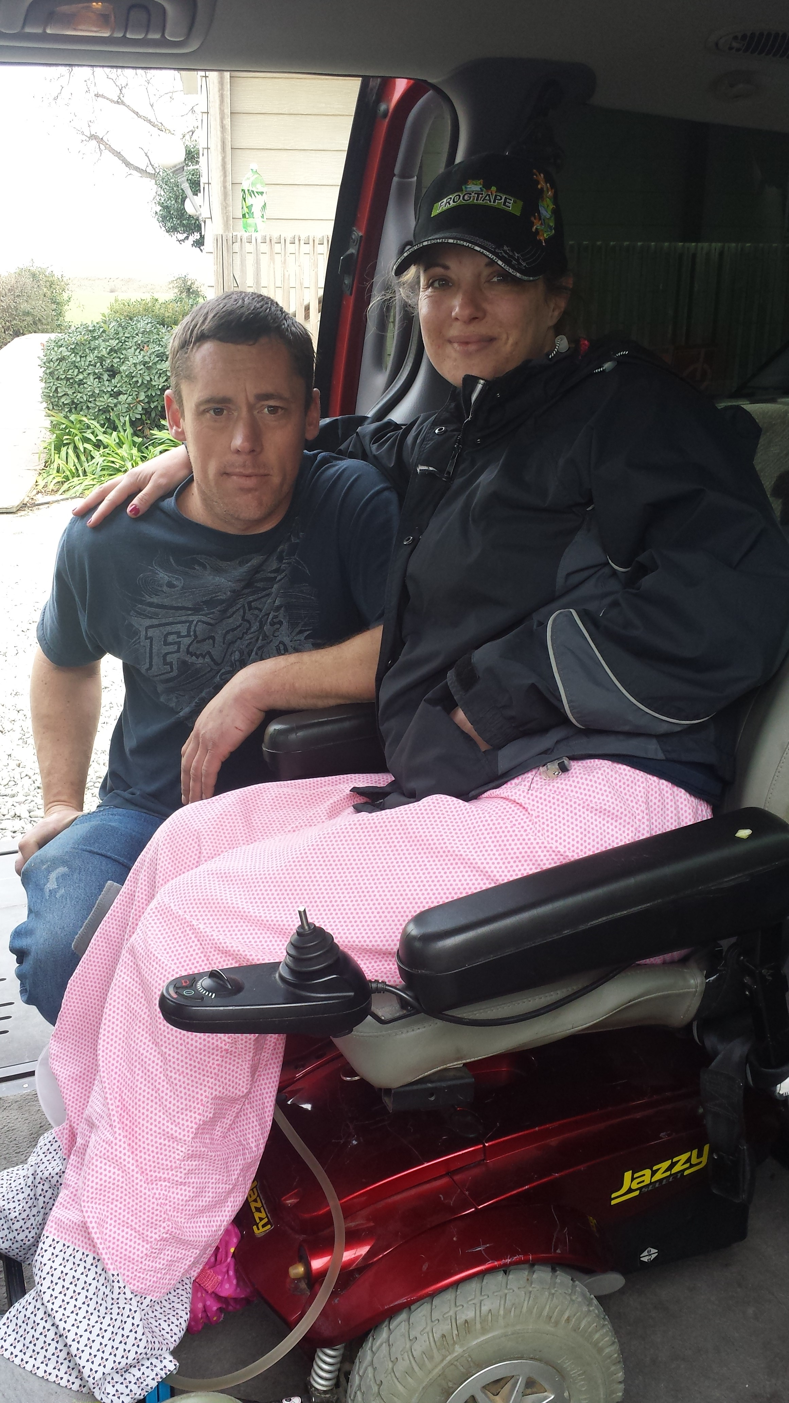
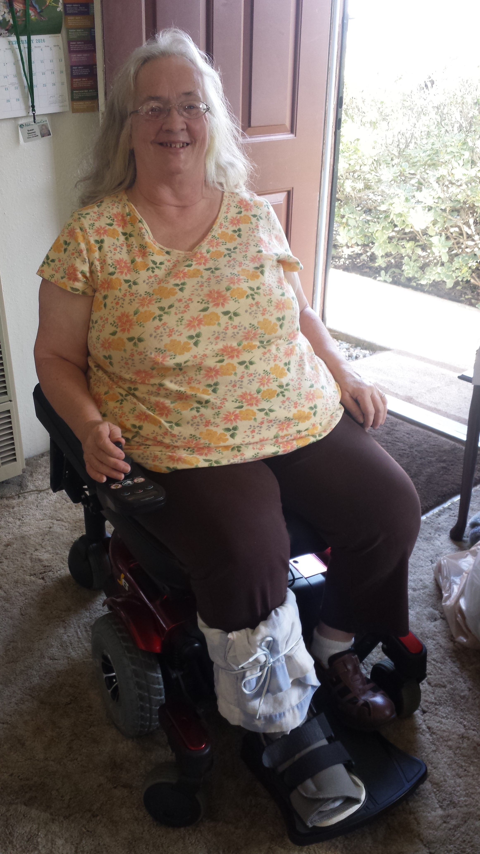
Some DAC’s Reuse Consumers
Consumer received a power wheelchair and ADA Van from Reuse Program
Consumer received a power wheelchair from Reuse Program

Slide 19
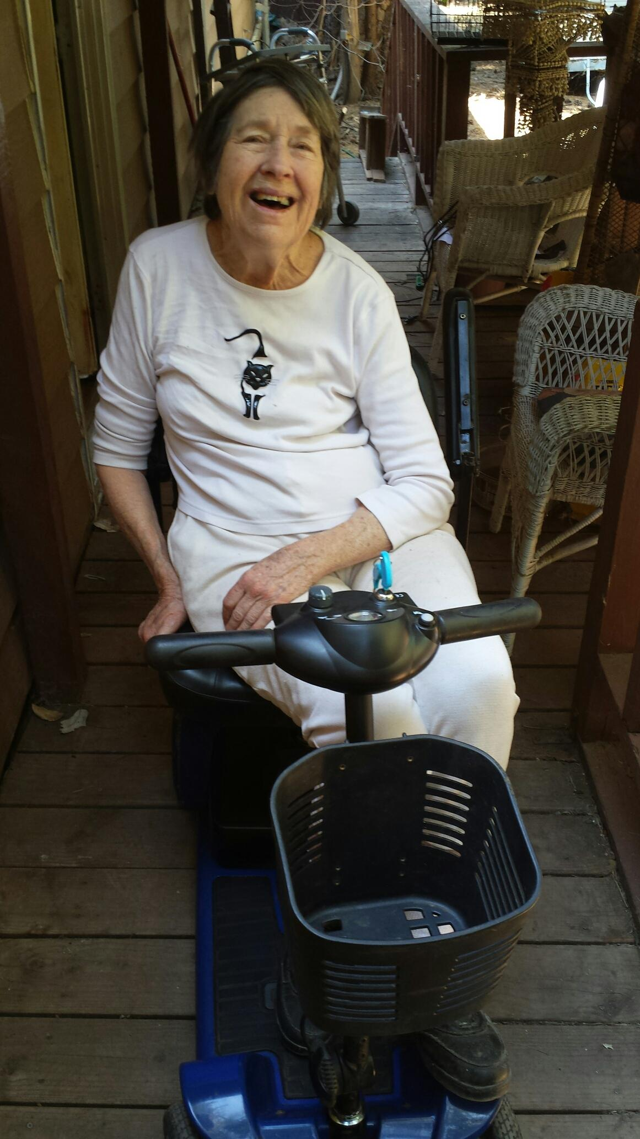
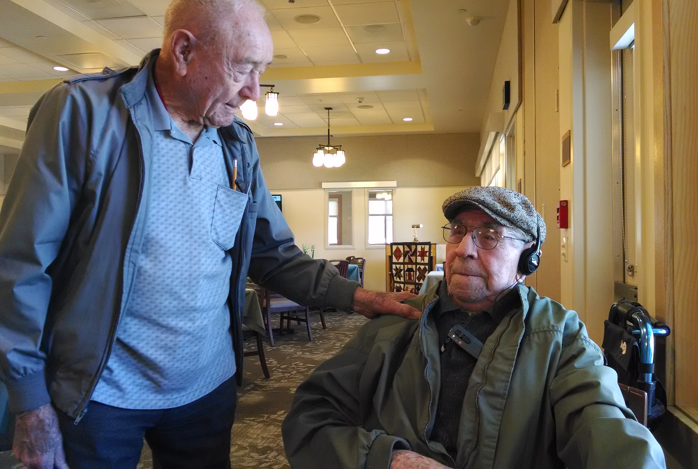
Some More reuse consumers
Consumer received a walker from Reuse Program
Consumer received a scooter from Reuse Program

Slide 20
Outreach and networking

Slide 21





Places to Go
Meetings to Attend
Contacts to Make
Successful
Collaboration and Networking

Slide 22
Collaboration and Networking
Hospitals
Retirement Communities
Rehabilitation Centers
Thrift Stores
Senior Centers
American Legion
Veterans Home
Lyons Club
School Districts
Rancheria
Veterans Stand Down
Homeless Shelters
Disable and Senior Coalitions
Resource Fairs
Service Providers
County Agencies
Other Nonprofit
Vendors
Charity Organizations
Health Fairs
Community Events
Fliers
Letters
Phone Calls
Facebook
Website
Postcards
PSA’s
Fundraisers
Radio Interviews

Slide 23
The future of our dme program

Slide 24
Ilr’s future
The Reuse program will continue to provide exceptional services to the Disabled and Seniors of the community
Will continue to seek funding to support the Reuse program
Will keep association and collaboration with agencies and organizations from the community across the county

Slide 25
Dac’s future
To find funding to hire a part time DME Reuse Assistant
Expand storage unit and install HUB Scrub on location
Create a repair shop that is equipped with needed tools
Expand more services to other counties regularly

Slide 26
Questions and answers

